Slide 1
Bringing insight to the decision-maker: communicating complex, multi-dimensional data using visual analytics in water resources applications
Timothy Adams, Umit Taner, Patrick Ray

Slide 2
What do decision makers want to know?
Where is my risk?
What can do I do to reduce my risk?

Slide 3
What do decision makers want to know?
Where is my risk?
What can do I do to reduce my risk?

Slide 4
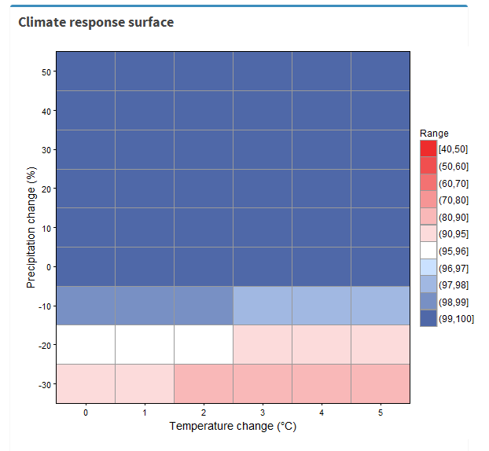
Hidden assumptions:
Demand
Dam size
…

